Slide 1
Android Notes Unit I

Slide 2
Introduction to Android

Slide 3
What is Android?
Android
Android is a Linux-based operating system designed primarily for touchscreen mobile devices; such as smartphones and tablet computers.
The first Android-powered phone was sold in October 2008.
Notes:
Android is an open source and Linux-based Operating System for mobile devices such as smartphones and tablet computers. Android was developed by the Open Handset Alliance, led by Google, and other companies.
Android offers a unified approach to application development for mobile devices which means developers need only develop for Android, and their applications should be able to run on different devices powered by Android.
The first beta version of the Android Software Development Kit (SDK) was released by Google in 2007 where as the first commercial version, Android 1.0, was released in September 2008.
On June 27, 2012, at the Google I/O conference, Google announced the next Android version, 4.1 Jelly Bean. Jelly Bean is an incremental update, with the primary aim of improving the user interface, both in terms of functionality and performance.
The source code for Android is available under free and open source software licenses. Google publishes most of the code under the Apache License version 2.0 and the rest, Linux kernel changes, under the GNU General Public License version 2.

Slide 4
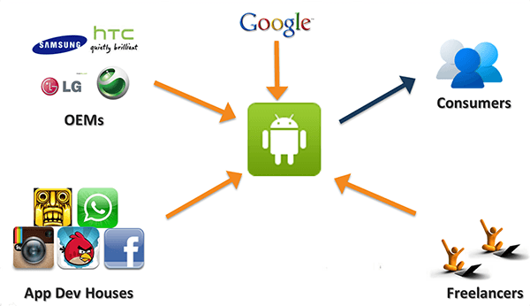
Android Ecosystem
Notes:
The very obvious stakeholders are the consumers that own Android devices, right! But there are others as well:
Google, because it develops Android.
OEMs (Original Equipment Manufacturers), who manufacture the hardware, and also the custom application components.
Application Development Companies: They are the biggest contributors to the ecosystem. They employ Android developers, and also outsource the product development to services companies.
Freelance Android developers, because they have the skill-set to contribute to the ecosystem. They create their apps, and publish them on Google playstore. Freelancers can also make money by developing applications for product companies.

Slide 5

History of Android
Android Inc.
Android, Inc. was founded in Palo Alto, California in October 2003 by Andy Rubin, Rich Miner, Nick Sears and Chris White.

Slide 6
The first android phone was HTC G1. Andy Rubin and his team were very excited about the first prototype of phone by Motorola and when it was brought in front of them this was their reaction: “It looked like a weapon. It was so sharp and jagged and full of hard lines. It looked like you could cut yourself on the edges”. Clearly, they were expecting something else.
Enter Google!
Google acquired Android Inc. on August 17, 2005, making it a wholly owned subsidiary. As the development advanced, Google marketed the platform to handset makers, promising them a smarter, more flexible and customizable system.
Notes:
https://www.androidpit.com/the-sweet-history-of-android

Slide 7
Android Applications
Android applications are usually developed in the Java language using the Android Software Development Kit.
Once developed, Android applications can be packaged easily and sold out either through a store such as Google Play, SlideME, Opera Mobile Store, Mobango, F-droid and the Amazon Appstore.
Notes:
Android powers hundreds of millions of mobile devices in more than 190 countries around the world. It's the largest installed base of any mobile platform and growing fast. Every day more than 1 million new Android devices are activated worldwide.
This tutorial has been written with an aim to teach you how to develop and package Android application. We will start from environment setup for Android application programming and then drill down to look into various aspects of Android applications.

Slide 8
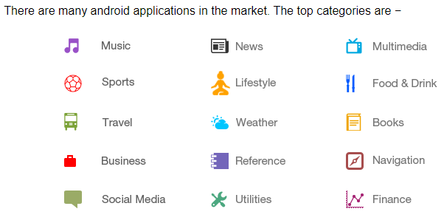
Categories of Android applications

Slide 9
What is Android versions?
Android is released in series of versions. Starting from 1.0 version ( where 2.0, 3.0, …. Are latest releases ).
Google name these versions with some food items like ice cream, jelly bean, sandwich etc. which is one of the specialty of android versions.
Notes:
https://youtu.be/leCGI9flgbE android version 2020 update
https://www.computerworld.com/article/3235946/android-versions-a-living-history-from-1-0-to-today.html?page=2

Slide 10
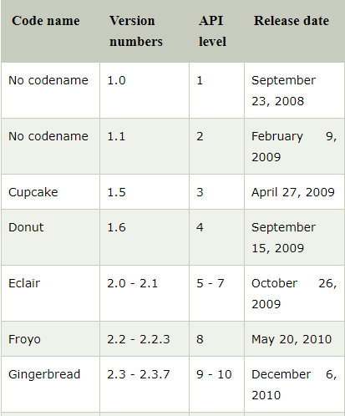
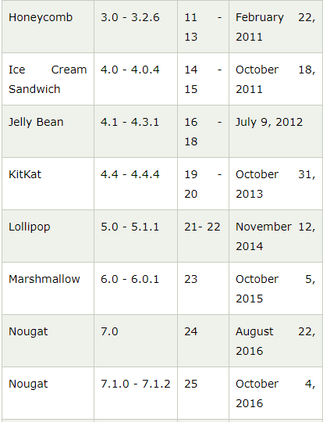
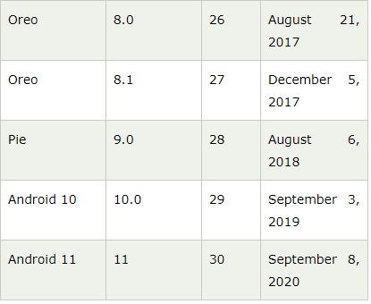

Slide 11
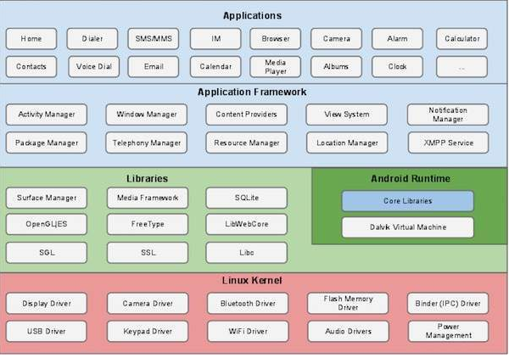
Android Architecture
Notes:
What is Android Architecture?
The Android OS is a software stack of different layers, in which each layer is a group of some program components. It includes operating system, middleware and important applications. Each layer in the architecture provides different services to the layer just above it.
Following are the different layers in the Android stack:
Linux Kernel Layer
Native Layer
Application Framework Layer
Applications layer

Slide 12
Linux kernel
At the bottom of the layers is Linux - Linux 3.6 with approximately 115 patches. This provides a level of abstraction between the device hardware and it contains all the essential hardware drivers like camera, keypad, display etc. Also, the kernel handles all the things that Linux is really good at such as networking and a vast array of device drivers, which take the pain out of interfacing to peripheral hardware.
Libraries
On top of Linux kernel there is a set of libraries including open-source Web browser engine WebKit, well known library libc, SQLite database which is a useful repository for storage and sharing of application data, libraries to play and record audio and video, SSL libraries responsible for Internet security etc.

Slide 13
Android Libraries
This category encompasses those Java-based libraries that are specific to Android development. Examples of libraries in this category include the application framework libraries in addition to those that facilitate user interface building, graphics drawing and database access. A summary of some key core Android libraries available to the Android developer is as follows −
android.app − Provides access to the application model and is the cornerstone of all Android applications.
android.content − Facilitates content access, publishing and messaging between applications and application components.
android.database − Used to access data published by content providers and includes SQLite database management classes.

Slide 14
android.opengl − A Java interface to the OpenGL ES 3D graphics rendering API.
android.os − Provides applications with access to standard operating system services including messages, system services and inter-process communication.
android.text − Used to render and manipulate text on a device display.
android.view − The fundamental building blocks of application user interfaces.
android.widget − A rich collection of pre-built user interface components such as buttons, labels, list views, layout managers, radio buttons etc.
android.webkit − A set of classes intended to allow web-browsing capabilities to be built into applications.

Slide 15
What is Android Run-time? Android Runtime consists of Dalvik Virtual machine and Core Java libraries.
Notes:
This is the third section of the architecture and available on the second layer from the bottom. This section provides a key component called Dalvik Virtual Machine which is a kind of Java Virtual Machine specially designed and optimized for Android.
The Dalvik VM makes use of Linux core features like, which memory management and multi-threading is intrinsic in the Java language. The Dalvik VM enables every Android application to run in its own process, with its own instance of the Dalvik virtual machine.
The Android runtime also provides a set of core libraries which enable Android application developers to write Android applications using standard Java programming language.

Slide 16
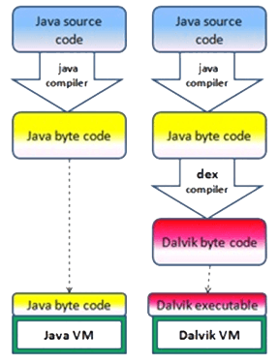
Notes:
Dalvik Virtual Machine
DVM is optimized for low processing power and low memory environments. Unlike JVM, the Dalvik Virtual Machine doesn’t run .class files, instead it runs .dex files.
As shown in the above figure, Java source code is first converted into Java byte code and then into Dalvik byte code using dex compiler.

Slide 17
Application Framework
The Application Framework layer provides many higher-level services to applications in the form of Java classes. Application developers are allowed to make use of these services in their applications.
The Android framework includes the following key services −
Activity Manager − Controls all aspects of the application lifecycle and activity stack.
Content Providers − Allows applications to publish and share data with other applications.
Resource Manager − Provides access to non-code embedded resources such as strings, color settings and user interface layouts.
Notifications Manager − Allows applications to display alerts and notifications to the user.
View System − An extensible set of views used to create application user interfaces.

Slide 18
Applications
You will find all the Android application at the top layer. You will write your application to be installed on this layer only. Examples of such applications are Contacts Books, Browser, Games etc.

Slide 19
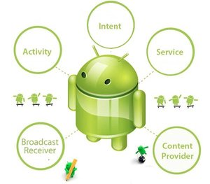
Android Building blocks
Notes:
https://www.tutorialspoint.com/android/android_application_components.htm

Slide 20
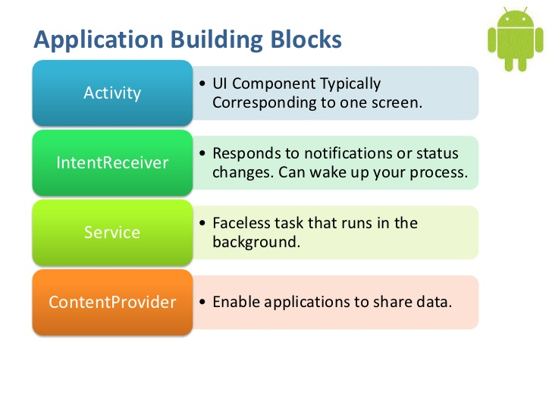

Slide 21
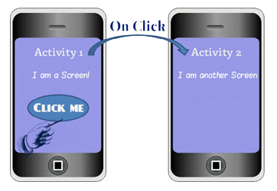
What is Android Activity?
Notes:
Activity provides the user a screen ‘or’ interface to interact with the application.
Each screen of an application is a different activity (Yes, every application has multiple). You can understand this using the following image: The first Activity (screen) has a button, which when clicked leads the user to a second screen, which is the second activity.

Slide 22
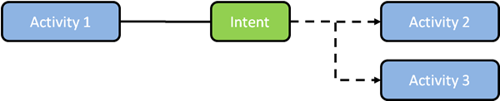
What is Android Intent?
Notes:
Intent is a message to communicate an action. It is a description of what you want done, example: VIEW VIDEO, PLAY GAME etc.
They are commands which when called would act as communicators between the three core components of Android, i.e. Activities, Services and Broadcast Receivers.
While you are interacting with one activity, you might want to switch to another one; this is done by defining a proper Intent for the action. Here one Activity uses Intent to request the launch of another Activity. Thus, it is evident that using intents, one Android component can request action from the other components of Android.

Slide 23
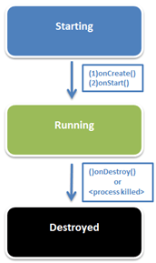
Services
Notes:
Some key points about Services:
1) Services are often called ‘faceless components’ of Android because they lack a user interface. Unlike activities, they run in the background.
2) They carry out long-running tasks desired by the application (without user intervention), like the background music in your Android application.
3) Services have specific jobs, and they are unaffected by activity switching. Even if you switch to a different application screen, they would continue to run.
4) They provide functionality to other applications.
5) Example of Service: A good example is your music player.

Slide 24
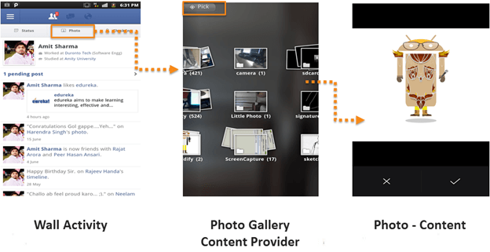
What is Android Content Provider?
Notes:
Content providers manage access to a structured set of data. They encapsulate the data, and provide mechanisms for defining data security. Content provider is the standard interface that connects data in one process with code running in another process.
Your Facebook Wall is an “ACTIVITY”. As you click on the Photo Button, an “INTENT” is passed, that conveys the message and the “CONTENT PROVIDER” (Photo Gallery) opens. The photo is uploaded using a network upload “SERVICE”.

Slide 25
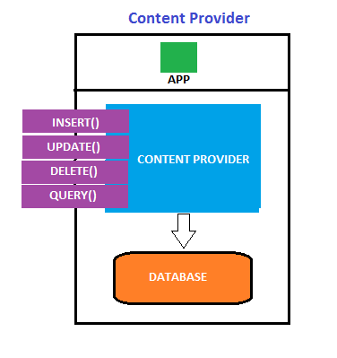
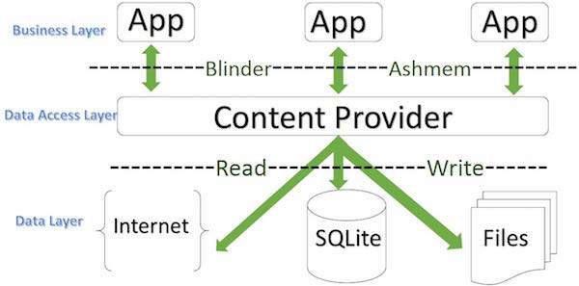

Slide 26
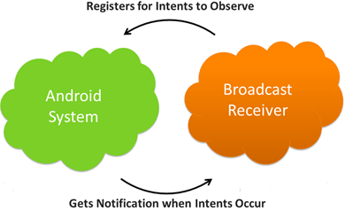
What are Broadcast Receivers?
Notes:
Using a Broadcast Receiver, applications can register for a particular event. Once the event occurs, the system will notify all the registered applications.

Slide 27
INTRODUCING THE DEVELOPMENT FRAMEWORK
Android applications normally are written using Java as the programming language but executed by means of a custom VM called Dalvik, rather than a traditional Java VM.
Each Android application runs in a separate process within its own Dalvik instance, relinquishing all responsibility for memory and process management to the Android run time, which stops and kills processes as necessary to manage resources.
Dalvik and the Android run time sit on top of a Linux kernel that handles low-level hardware interaction, including drivers and memory management, while a set of APIs provides access to all the underlying services, features, and hardware.
Notes:
https://developer.android.com/studio/intro

Slide 28
What Comes in the Box
The Android SDK includes everything you need to start developing, testing, and debugging Android applications:
The Android APIs — The core of the SDK is the Android API libraries that provide developer access to the Android stack. These are the same libraries that Google uses to create native Android applications.
Development tools — The SDK includes several development tools that let you compile and debug your applications so that you can turn Android source code into executable applications.

Slide 29
The Android Virtual Device Manager and emulator — The Android emulator is a fully interactive mobile device emulator featuring several alternative skins. The emulator runs within an Android Virtual Device (AVD) that simulates a device hardware configuration. Using the emulator you can see how your applications will look and behave on a real Android device. All Android applications run within the Dalvik VM, so the software emulator is an excellent development environment — in fact, because it’s hardware-neutral, it provides a better independent test environment than any single hardware implementation.
Full documentation — The SDK includes extensive code-level reference information detailing exactly what’s included in each package and class and how to use them. In addition to the code documentation, Android’s reference documentation and developer guide explains how to get started, gives detailed explanations of the fundamentals behind Android development, highlights best practices, and provides deep-dives into framework topics.

Slide 30
Sample code — The Android SDK includes a selection of sample applications that demonstrate some of the possibilities available with Android, as well as simple programs that highlight how to use individual API features.
Online support — Android has rapidly generated a vibrant developer community. The Google Groups (http://developer.android.com/resources/community-groups
.html#ApplicationDeveloperLists) are active forums of Android developers with regular input from the Android engineering and developer relations teams at Google. Stack Overflow (www.stackoverflow.com/questions/tagged/android) is also a hugely popular destination for Android questions and a great place to fi nd answers to beginner questions.

Slide 31
Android Application Architecture
Android’s architecture encourages component reuse, enabling you to publish and share Activities, Services, and data with other applications, with access managed by the security restrictions you define.
The same mechanism that enables you to produce a replacement contact manager or phone dialer can let you expose your application’s components in order to let other developers build on them by creating new UI front ends or functionality extensions.

Slide 32
The following application services are the architectural cornerstones of all Android applications, providing the framework you’ll be using for your own software:
Activity Manager and Fragment Manager — Control the lifecycle of your Activities and Fragments, respectively, including management of the Activity stack.
Views — Used to construct the user interfaces for your Activities and Fragments,
Notification Manager — Provides a consistent and nonintrusive mechanism for signaling your users.
Content Providers — Lets your applications share data.
Resource Manager — Enables non-code resources, such as strings and graphics, to be externalized.
Intents — Provides a mechanism for transferring data between applications and their components.

Slide 33
Types of Android Applications
❑ Foreground Activity An application that’s only useful when it’s in the foreground and is effectively suspended when it’s not visible. Games and map are common examples.
❑ Background Service An application with limited interaction that, apart from when being configured, spends most of its lifetime hidden.
Examples of this include call screening applications or SMS auto-responders.
❑ Intermittent Activity Expects some interactivity but does most of its work in the background. Often these applications will be set up and then run silently, notifying users when appropriate. A common example would be a media player.

Slide 34
Foreground Activities
When creating foreground applications, you need to consider the Activity life cycle carefully so that the Activity switches seamlessly between the foreground and the background.
Applications have no control over their life cycles, and a backgrounded application, with no Services,
is a prime candidate for cleanup by Android’s resource management.
This means that you need to savethe state of the application when the Activity becomes invisible, and present the exact same state when it returns to the foreground.
It’s also particularly important for foreground Activities to present a slick and intuitive user experience.

Slide 35
Background Services
These applications run silently in the background with very little user input.
They often listen for messages or actions caused by the hardware, system, or other applications, rather than rely on user interaction.
It’s possible to create completely invisible services, but in practice, it’s better form to provide at least some sort of user control.
At a minimum, you should let users confirm that the service is running and let them configure, pause, or terminate it as needed.

Slide 36
Intermittent Activities
Often you’ll want to create an application that reacts to user input but is still useful when it’s not the active foreground Activity.
These applications are generally a union of a visible controller Activity with an invisible background Service.
These applications need to be aware of their state when interacting with the user.
This might mean updating the Activity UI when it’s visible and sending notifications to keep the user updated when it’s in the background,

Slide 37
Android Development Tools
The Android SDK includes several tools and utilities to help you create, test, and debug your projects.
the ADT plug-in conveniently incorporates most of these tools into the Eclipse IDE,
❑ The Android Virtual Device and SDK Managers — Used to create and manage AVDs and to download SDK packages, respectively. The AVD hosts an Emulator running a particular build of Android, letting you specify the supported SDK version, screen resolution, amount of SD card storage available, and available hardware capabilities (such as touchscreens and GPS).
❑ The Android Emulator An implementation of the Android virtual machine designed to run on your development computer. You can use the emulator to test and debug your android applications.
❑ Dalvik Debug Monitoring Service (DDMS) Use the DDMS perspective to monitor and control the Dalvik virtual machines on which you’re debugging your applications.
❑ Android Asset Packaging Tool (AAPT) Constructs the distributable Android package fi les (.apk).

Slide 38
❑ Android Debug Bridge (ADB) The ADB is a client-server application that provides a link to a running emulator. It lets you copy files, install compiled application packages (.apk), and run shell commands.
The following additional tools are also available:
❑ SQLite3 A database tool that you can use to access the SQLite database fi les created and used by Android
❑ Traceview Graphical analysis tool for viewing the trace logs from your Android application
❑ MkSDCard Creates an SDCard disk image that can be used by the emulator to simulate an external storage card.
❑ dx Converts Java .class bytecode into Android .dex bytecode.
❑ activityCreator Script that builds Ant build fi les that you can then use to compile your Android applications without the ADT plug-in.
❑ Hierarchy Viewer — Provides both a visual representation of a layout’s View hierarchy to debug and optimize your UI, and a magnifi ed display to get your layouts pixel-perfect.
❑ Lint — A tool that analyzes your application and its resources to suggest improvements and optimizations.

Slide 39
The Android Emulator
The emulator is the perfect tool for testing and debugging your applications, particularly if you don’t have a real device (or don’t want to risk it) for experimentation.
The Emulator is an implementation of the Dalvik VM, making it as valid a platform for running Android applications as any Android phone. Because it’s decoupled from any particular hardware, it’s an excellent baseline to use for testing your applications.

Slide 40
Dalvik Debug Monitor Service (DDMS)
The emulator lets you see how your application will look, behave, and interact,
but to really see what’s happening under the surface, you need the DDMS.
The Dalvik Debug Monitoring Service is a powerful debugging tool that lets you interrogate active processes, view the stack and heap, watch and pause active threads, and explore the filesystem of any active emulator.
The DDMS perspective in Eclipse also provides simplified access to screen captures of the emulator and the logs generated by LogCat.

Slide 41
The Android Debug Bridge (ADB)
The Android debug bridge (ADB) is a client-service application that lets you connect with an Android Emulator or device.
It’s made up of three components: a daemon running on the emulator, a service that runs on your development hardware, and client applications (like the DDMS) that communicate with the daemon through the service.
As a communications conduit between your development hardware and the Android device/emulator, the ADB lets you install applications, push and pull files, and run shell commands on the target device.
Using the device shell, you can change logging settings, and query or modify SQLite databases available on the device.

Slide 42
What Makes an Android Application?
There are six components that provide the building blocks for your applications:
❑ Activities
Your application’s presentation layer.
Every screen in your application will be an extension of the Activityclass.
Activities use Views to form graphical user interfaces that display information and respond to user actions.
In terms of desktop development, an Activity is equivalent to a Form.
❑ Services
The invisible workers of your application.
Service components run invisibly, updating your data sources and visible Activities and triggering Notifications.
They’re used to perform regular processing that needs to continue even when your application’s Activities aren’t active or visible.

Slide 43
❑ Content Providers
A shareable data store.
Content Providers are used to manage and share application databases.
Content Providers are the preferred way of sharing data across application boundaries.
This means that you can configure your own Content Providers to permit access from other applications and use Content Providers exposed by others to access their stored data.
Android devices include several native Content Providers that expose useful databases like contact information.
❑ Intents
A simple message-passing framework.
Using Intents, you can broadcast messages system-wide or to a target Activity or Service, stating your intention to have an action performed.
The system will then determine the target(s) that will perform any actions as appropriate.

Slide 44
❑ Broadcast Receivers
Intent broadcast consumers.
By creating and registering a Broadcast Receiver, your application can listen for broadcast Intents that match specific filter criteria.
Broadcast Receivers will automatically start your application to respond to an incoming Intent, making them ideal for event-driven applications.
❑ Notifications
A user notification framework.
Notifications let you signal users without stealing focus or interrupting their current Activities.
They’re the preferred technique for getting a user’s attention from within a Service or Broadcast Receiver.
For example, when a device receives a text message or an incoming call, it alerts you by flashing lights, making sounds, displaying icons, or showing dialog messages.
You can trigger these same events from your own applications using Notifications.

Slide 48
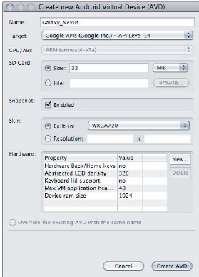
Android Virtual Device Manager
The Android Virtual Device Manager is used to create and manage the virtual devices that will host instances of the Emulator.
AVDs are used to simulate the software builds and hardware configurations available on different physical devices. This lets you test your application on a variety of hardware platforms without needing to buy a variety of phones.
Notes:
https://developer.android.com/studio/run/managing-avds

Slide 49
The additional settings include the following:
‰ Maximum VM heap size
‰ Screen pixel density
‰ SD card support
‰ Existence of D-pad, touchscreen, keyboard,
and trackball hardware
‰ Accelerometer, GPS, and proximity sensor support
‰ Available device memory
‰ Camera hardware (and resolution)
‰ Support for audio recording
‰ Existence of hardware back and home keys

Slide 50
SDK manager
The Android SDK Manager can be used to see which version of the SDK you have installed and to install new SDKs when they are released.
Each platform release is displayed, along with the platform tools and a number of additional support packages. Each platform release includes the SDK platform, documentation, tools, and examples corresponding to that release.
Notes:
https://developer.android.com/studio/intro/update

Slide 51
Installing and configuring Android SDK, ADT and AVD
Notes:
https://developer.android.com/studio/install
https://developer.android.com/studio/intro/studio-config

Slide 54
Thank you

